Slide 2
Idea
Teaching and science education problem
Myth and facts about e-learning !?
What is true and what we are dreaming is true?
Real and virtual;
Laboratory vs abstract thinking
During the last decade, teachers/trainers of science and technology subjects have been faced with an extensive use of computer based approach in teaching technology. Basics science, and particularly physics, related concepts of mechanics and electrical engineering were treated through software schematics, simulations and extensive use of all kinds of virtualization technologies.
E-learning, although very important part in modern society teaching curricula, represents only ingredient in efficient teaching technology process.
Complete and effective knowledge can be reached only through proper combination of "virtual" tools and "real" laboratory work joined together with more abstract and generic scientific concepts. Only such knowledge can be economy proactive because it brings long-term skills in lifetime education

Slide 3
Resources
Tradition is important
People resources seems to be most important
Institutional support ??
Are there any and who needs it ?!
SŠ Mate Blažine Labin
Elektrostrojarska škola Varaždin
The concept of integrating both "real" and "virtual" laboratory learning environments was implemented in example courses developed within the ComLab projects (ComLab-SciTech project SI/143008 and ComLab-2 SI/05/B/F/PP-176008 finished in 2007, http://e-prolab.com/).
The main objectives of the proposed project are related to the development and implementation of contemporary learning process by using ICT tools integrating real and virtual laboratory. Partner from Slovenia involved in ComLab project have competence to develop computer based laboratories.
Beside Faculty of Sciences (particularly Physics Department of Zagreb University) partners of Croatia are secondary vocational schools with developing program in robotics and mechatronics.
They will shape achieved positive experience focusing on methodical implications unifying it in comprehensive scientific environment. Partners from Romania and Turkey will transfer and disseminate the positive consequences of the implementation of this innovation achieved combining it with own teaching skills and experience.

Slide 4
Cooperation and outcomes:
(i) implementation, adaptation and enhancement of existing ComLab courses, software and equipment according to the curriculum of vocational secondary schools
(ii) development and design of new courses, software and laboratory equipment,
(iii) implementation of low-cost and freeware,
open-source software,
(iv) integration of "conventionally hard" physics concepts in attractive robotics environment
(v) development of new practices and methods for teaching integrated approach in school laboratory,
(vi) dissemination of this innovative equipment and approach across vocational schools in all partner countries and wider establishing "International Summer Schools in Robotics and Electronics“.
All partners are committed to cooperate with at least one vocational school in each country in order to obtain feed-back from the target groups as well as "real time" testing and evaluation.

Slide 5
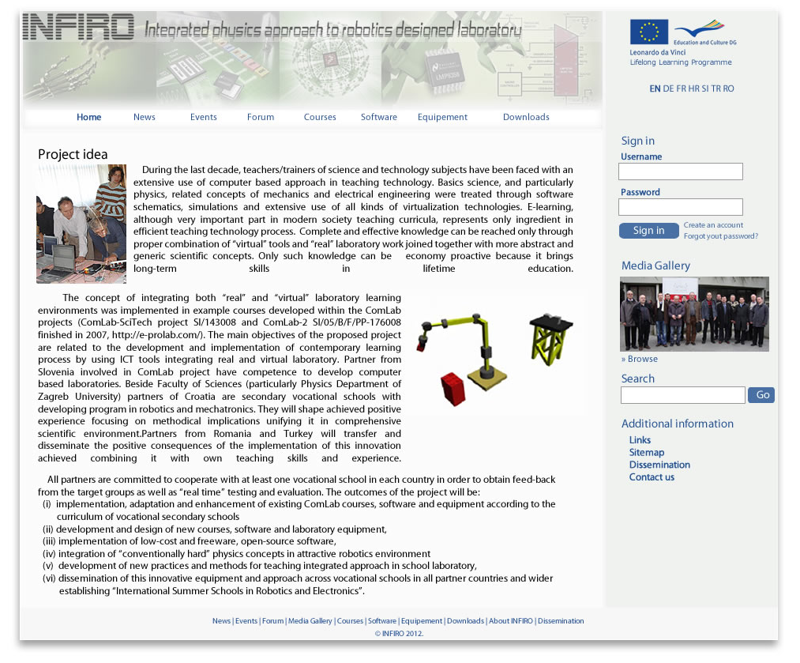

Slide 6
Open Concept
Inside already mentioned limitations with the general framework we are open for further collaborations!

