Slide 1
1
Young Mathematicians’ Summer Camp
Nikola Adžaga
Petar Bakić
Young Gifted Mathematicians Marin Getaldić association
Toward a Platform for Motivated and Gifted Youth
www.getaldic.org
Notes:
1

Slide 2
Young Gifted Mathematicians
"Marin Getaldić"
- non-profit, volunteer student organisation
Projects:
- weekly lectures
- summer camp
- Tournament of Towns (Zagreb)
Future projects:
- interactive online problem archive ("Skoljka")
- video lectures
Abandoned projects:
- OCCM

Slide 3
Methods
interactive math lectures
popular science lectures
"real life problem"
"rally"

Slide 4
Interactive math lectures

Slide 5
Interactive math lectures
primary method
small groups (3-10)
theoretical part, examples
students:
solve problems
receive hints
present their solutions
problem: different prior knowledge

Slide 6
Popular science lectures
physics, astronomy, biology, computer science, financial mathematics...
usually held by prominent Croatian scientists
ex cathedra lecture
advanced topic

Slide 7
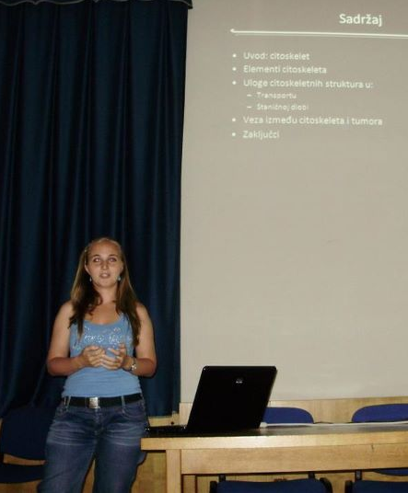
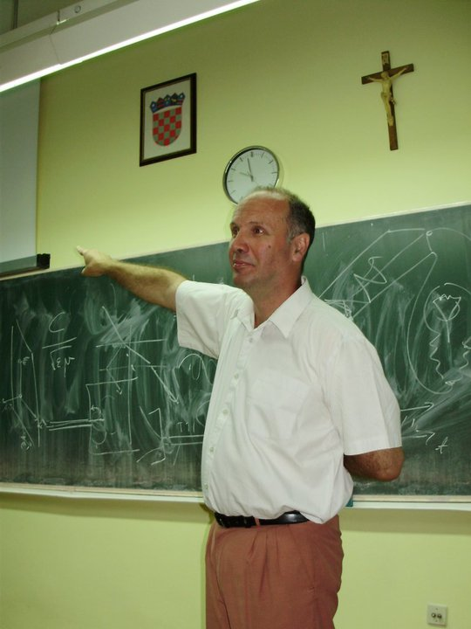
Popular science lectures

Slide 8
"Real life problem"
problem given by our sponsor
development and implementation of an algorithm
not all students participate
presentation of the solution to the sponsor (after the summer camp)

Slide 9
"Rally"
group contest (3-5 students per team)
a number of demanding mathematical problems
solutions are presented immediately
evaluated by the mentors
each team member has to present at least one solution, so everyone must participate
=> peer learning

Slide 10
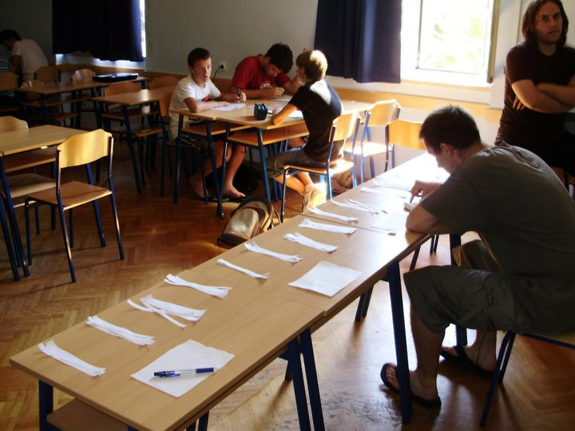
"Rally"

Slide 11
General problems
- lack of pedagogical/psychological skills
- small number of students (almost exclusively from Zagreb)
- limited collaboration with schools
- small number of active members

Slide 12
