Slide 1
SRC BISTRA PTUJ LINKING BUSINESS, RESEARCH AND LOCAL COMMUNITY FOR FUTURE ECONOMY
Dr. Aleksandra Pivec
ZRS BISTRA PTUJ

Slide 2
PTUJ
The oldest town in Slovenia
Number of inhabitants: 23.716.
Region: Spodnje Podravje

Slide 3
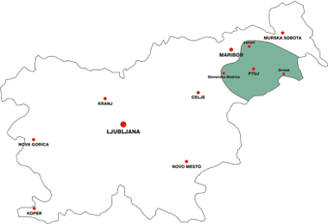
Spodnje Podravje

Slide 4
ZRS Bistra Ptuj is a supporting environment for the regional development facilitating research, innovativeness, entrepreneurship and cooperation on all levels.
ZRS BISTRA PTUJ est. 1994
Scientific research centre
BISTRA PTUJ

Slide 5
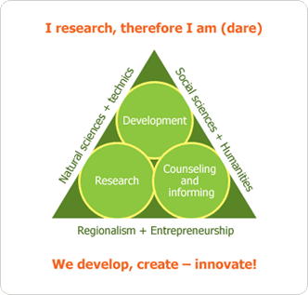
SRC Bistra Ptuj presents a supporting structure of the developmental environment of the region, intended for local communities and enterprises.
OUR AIM:
Development excellence of the region Spodnje Podravje.
Networking in research.
Knowledge transfer from research institutions to enterprises.
Co-creation of research ideas and their transfer to research environment.
Promotion, creation and shaping the knowledge and human resources in the region.

Slide 6
Human resources of Bistra
23 full-timers:
6 experts for EU funds
3 regional managers
5 R&D experts
5 Ph.D, 1 M.Sc., 4 Ph.D. students

Slide 7
Bistra groups / units
Regional development agency
Research group
Project group
Centre for development of entrepreneurship

Slide 8
Regional development agency
Regarding regional development and entrepreneurship we offer a comprehensive organizational, technical and financial support to the region of Spodnje Podravje.
Following the objective of balanced regional development considering the Act on the promotion of balanced regional development and its implementing regulations.

Slide 9
Research group
Generating creative research and development space between business and academia.
Applied research – new products, new technologies.
Supporting the introduction of newly developed solutions to the production lines.
Networking and knowledge transfer from universities and institutes to the economy.

Slide 10
Project group
Bistra is a non-profit organisation.
National, cross border and transnational projects – over 20 projects currently running.
Administrative and financial support for the coordination, management and implementation of our own or joint projects.
Promotion of benefits and results of joint projects.

Slide 11
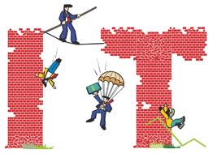
Centre for development of entrepreneurship
Promoting entrepreneurship and economic development in the region.
VEM (= all in one place) point: starting business in 1 hour, administrative procedures.
Counselling, workshops, seminars for entrepreneurs and prospects.

Slide 12
References - research
National research programme “Separation processes of greenhouse gasses for sustainable development”
14 applied research projects (waste management, energy efficiency, green energy, biotechnologies, culture...)
4 RIP projects – applied research and investing projects with total budget of over 6 mio € (Bosio, Inox, Gorenje, Albin Promotion)

Slide 13
References – cooperation
Over 30 projects in EU programs: CE, SEE, MED, SI-AT, SI-HR, SI-HU, INTERREG, 5FP, 6FP.
10 new applications sent in 2011.
Bringing academia and businesses together under coordination of Bistra:
Centres of excellense: 8 partners
Centres of competence: 13 partners
Development centres: 17 partners

Slide 14
YOUTH RESEARCH
One of the most important objectives of the Scientific Research Centre Bistra Ptuj is the formation of a creative research and development space between the economic and the academic sphere.
With the project “Early stage young researchers” we wish to develop a modern lifelong learning model through a process of PREPARATION, PRODUCTION and PRESENTATION of research tasks, which will enable a close connection of talented young students and their schools with universities, research institutions and most especially with business entities, economic subjects and other development actors.

Slide 15
Regional competition/meeting of the YOUNG RESEARCHERS from Spodnje Podravje and Prlekija
1993 - 2012

Slide 16
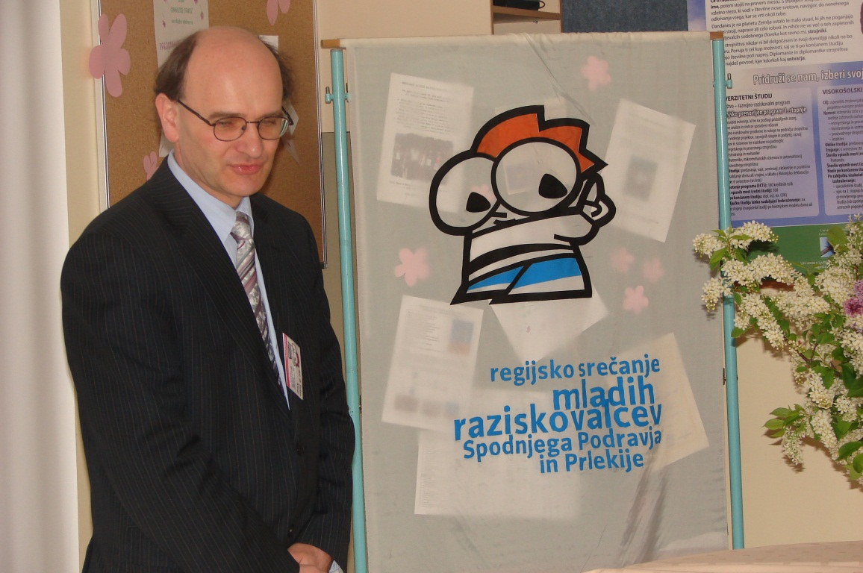
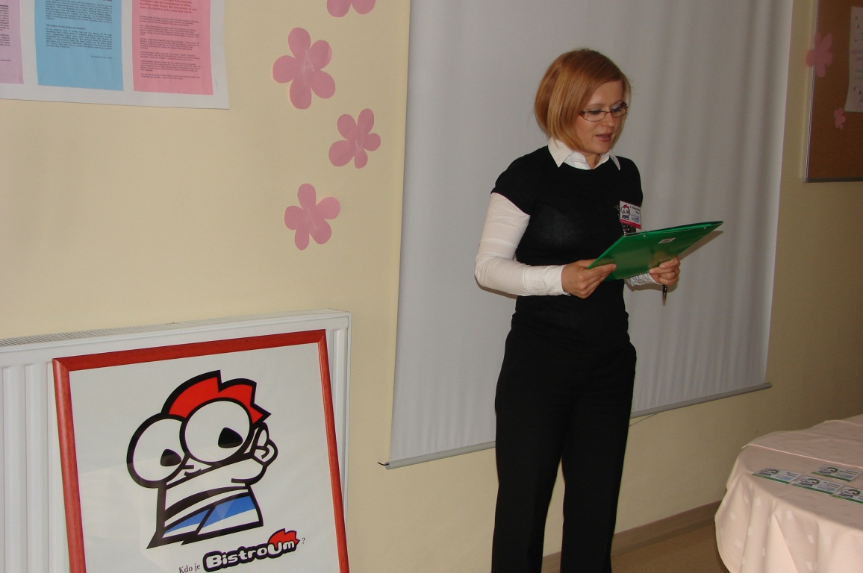
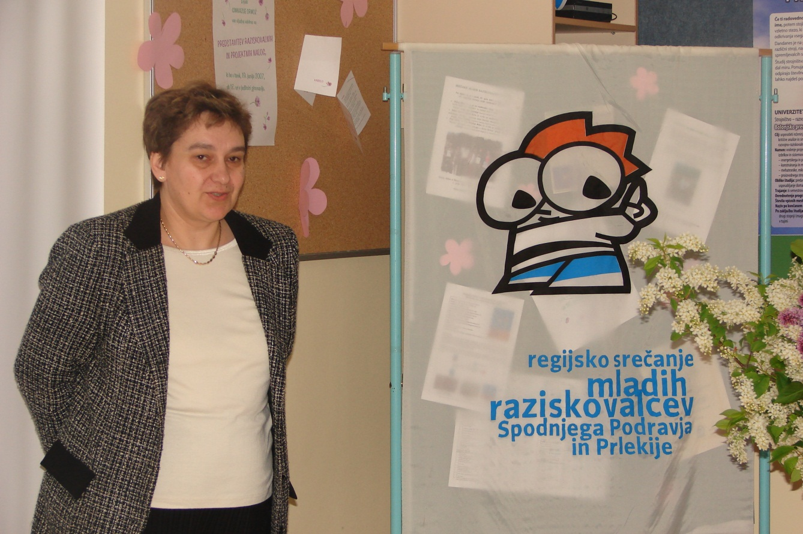

Slide 17
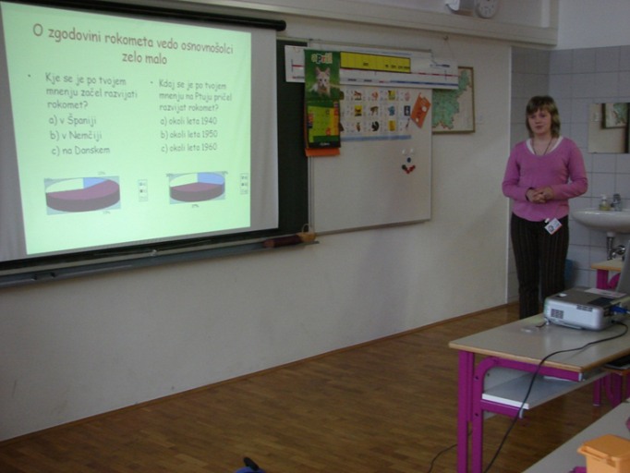
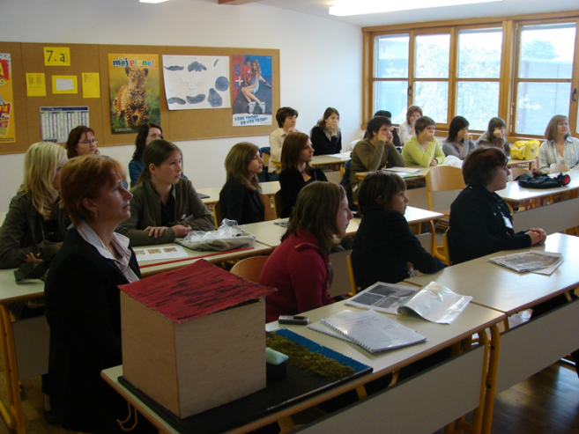
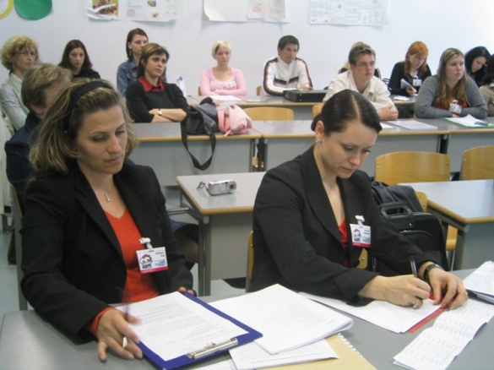
By participating in the project young people do:
strengthen self-confidence,
confidence in their work and thinking,
assess their own assumptions and knowledge
learn how to clearly and publicly express their opinions
develop certain skills important for life and critical thinking in addition
develop (healthy) and the competitive spirit state and trained for effective presentation skills

Slide 18
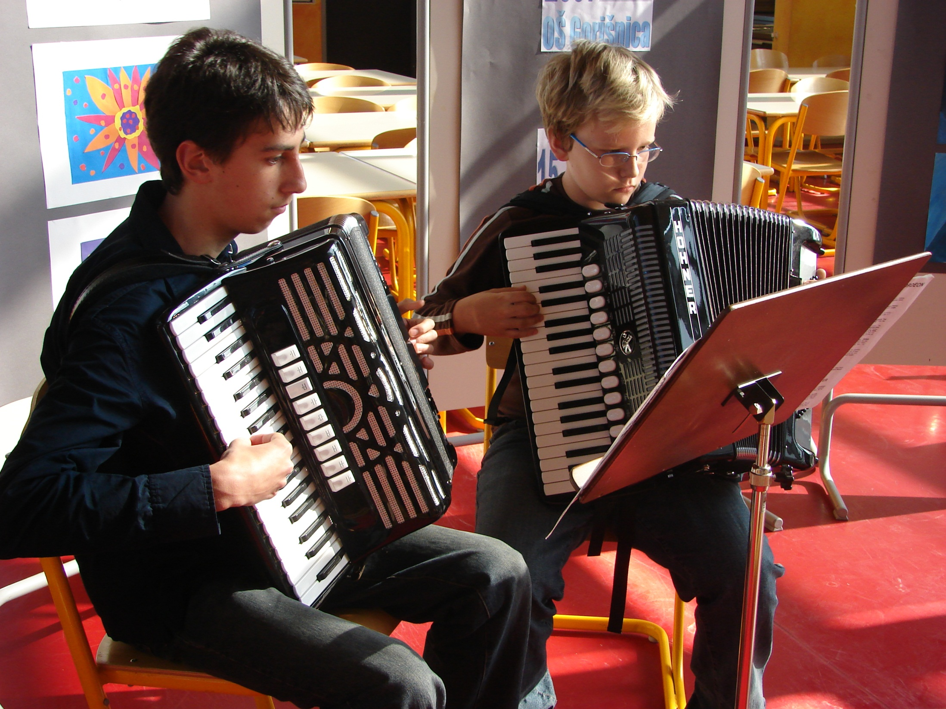

Slide 19
YOUTH RESEARCH WORK 1993 - 2012
20 REGIONAL COMPETITIONS of YOUNG RESEARCHERS FOR PRIMARY AND SECUNDARY SCHOOLS in Spodnje Podravje
28 PRIMARY SCHOOLS
6 SECUNDARY SCHOOLS

Slide 20
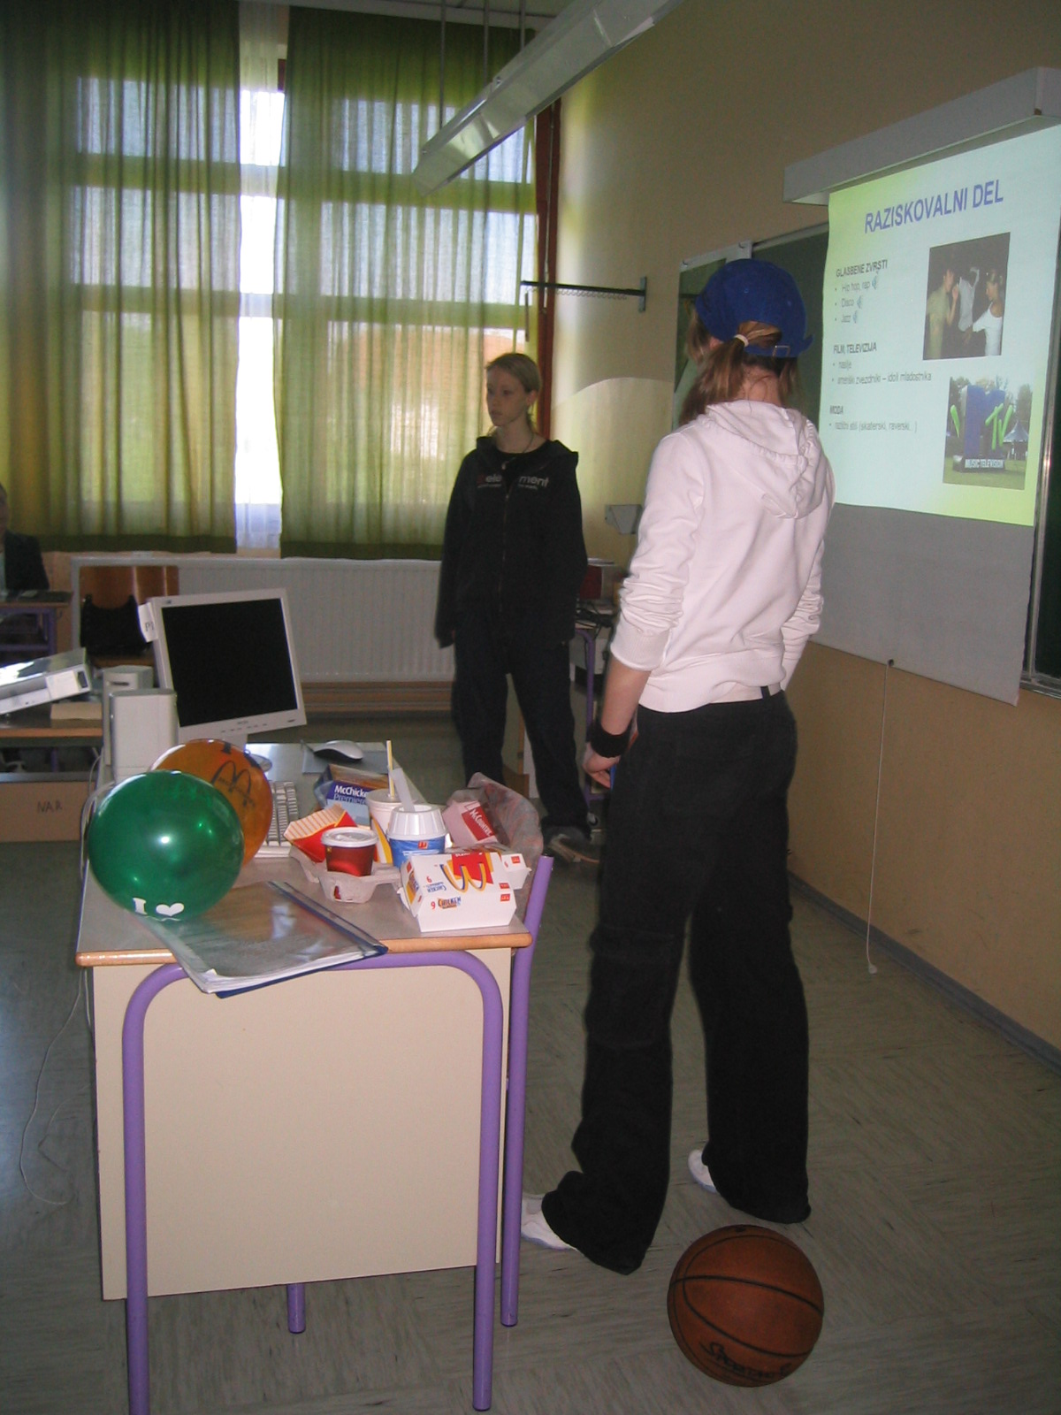
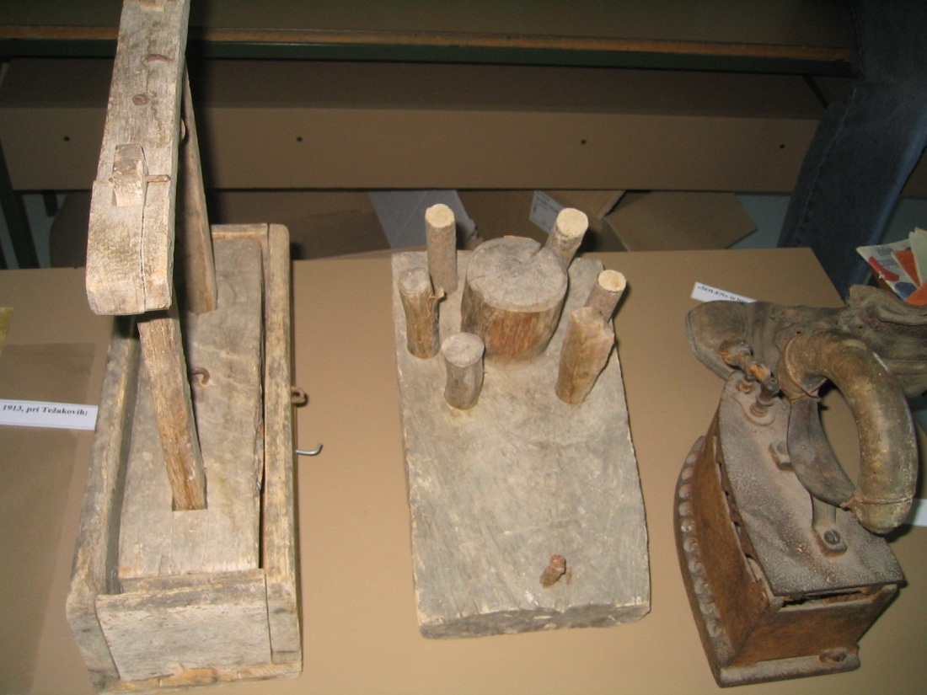
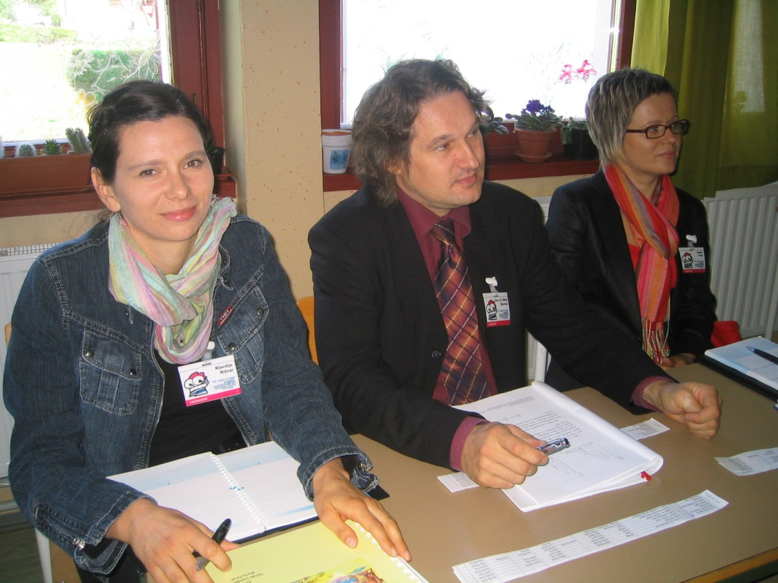
INTERESTING AND INNOVATIVE PRESENTATIONS OF THEIR RESEARCH WORKS

Slide 21
ACTIVITIES
PREPARATION OF THE TENDER FOR REGIONAL MEETING
ACTUAL AND APPLIED TOPICS FOR THE RESEARCH WORKS WHICH CAN BE USEFULL IN THE LOCAL ENVIRONMENT
STRUCTURE DESIGN OF THE RESEARCH PROJECT
ASSISTANCE IN SELECTING APPROPRIATE RESEARCH METHODS
TRAINING OF TRAINERS
ORGANIZATION OF THE MEETINGS AND COMPETITION (REGINOAL AND NATIONAL MEETING)
TRAINING OF REVIEWERS
PREPARATION AND PUBLISH OF PROCEEDINGS OF THE RESEARCH TASKS AND REVIEWS
PROMOTION OF THE PROJECT

Slide 22
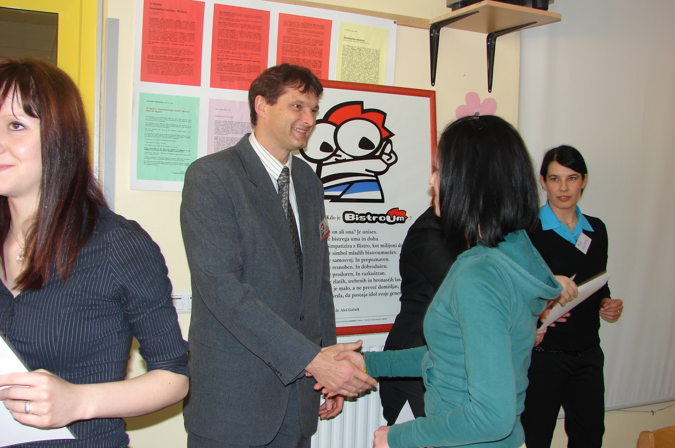
AWARDS

Slide 23
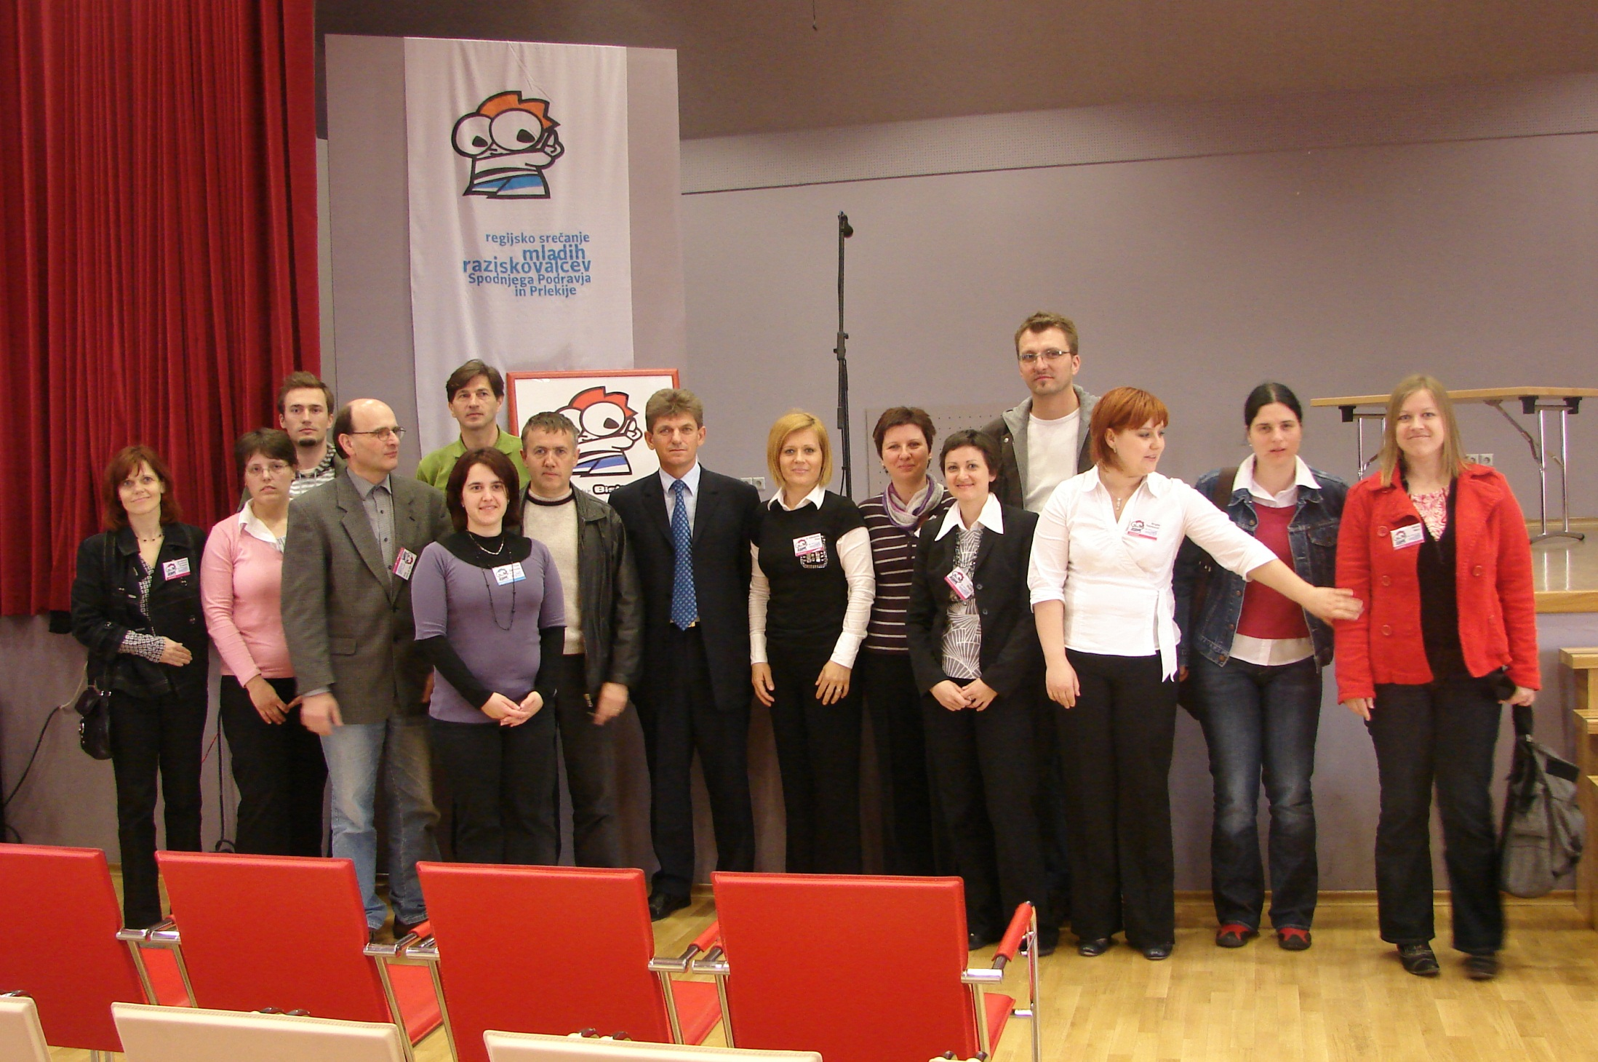
REVIEWERS

Slide 24
PUBLICATION
MISCELLANY OF REVIEWS

Slide 29
Let this saying lead young researchers in the spirit of free and open research creativity, curiosity and awareness of the importance of our own knowledge.
"I heard and I forgot. I saw and I remembered. I did and I can. "

